Slide 1

UNIVERSITY INSTITUTE OF ENGINEERING
COMPUTER SCIENCE ENGINEERING
Computer Vision (CST-422)
Prepared By : Payal Thakur(E12720)
Topic: Image Stitching: Introduction to Image Stitching, Stitching Images Example
DISCOVER . LEARN . EMPOWER

Slide 2
Introduction to Image Stitching
Image stitching is the process of combining multiple overlapping images to create a larger composite image that represents a wider field of view.
This technique is commonly used in panoramic photography, virtual tours, and surveillance systems.
The main goal of image stitching is to seamlessly blend the overlapping regions of the images to create a visually coherent composite image.

Slide 3
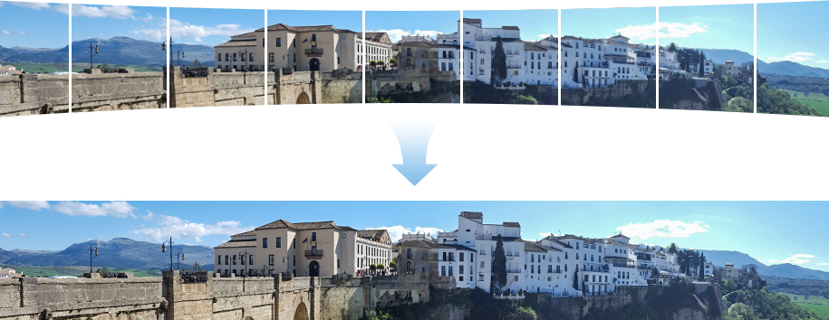
Introduction to Image Stitching

Slide 4
Image Stitching Pipeline
The image stitching pipeline consists of several steps that are performed sequentially to stitch the images together:
Image Acquisition: Multiple images of the same scene are captured either by moving the camera along a horizontal or vertical direction or by slightly changing the camera's viewpoint.
Feature Detection and Matching: In this step, distinctive points in each image, known as keypoints, are detected using feature detection algorithms such as Scale-Invariant Feature Transform (SIFT) or Speeded-Up Robust Features (SURF). These keypoints are then matched across different images using techniques like nearest neighbor or Random Sample Consensus (RANSAC). The goal is to find correspondences between the keypoints in different images.
Image Alignment: The images are aligned to compensate for camera motion, rotation, and scale differences. The homography matrix is used to represent the geometric transformation between two images. Homography estimation algorithms like Direct Linear Transform (DLT) or RANSAC are employed to calculate the homography matrix based on the matched keypoints.
Image Warping: Once the images are aligned, they need to be warped to a common coordinate system. The estimated homography matrix is used to map the pixels from the original images to the common coordinate system. This process ensures that the aligned images are properly registered with each other.

Slide 5
Image Stitching Pipeline
Blending: The overlapping regions of the warped images need to be blended to create a seamless composite image. Various blending techniques can be used, such as linear blending, gradient-based blending, or multi-band blending. The goal is to eliminate visible seams and ensure smooth transitions between the images.
Post-processing: Additional adjustments can be applied to enhance the final stitched image. These adjustments may include color correction, exposure matching, and distortion correction. These steps help in achieving a visually pleasing and realistic composite image.
Evaluation and Fine-tuning: The quality of the stitched image can be evaluated by visually inspecting the composite image for any artifacts or misalignments. If needed, fine-tuning adjustments can be made to improve the final result.

Slide 6
Stitching Images Example
To demonstrate the image stitching process, you can follow these steps:
Dataset Preparation: Gather a set of overlapping images that capture the same scene. These images should cover the desired field of view.
Feature Extraction and Matching: Use feature detection algorithms, such as SIFT or SURF, to extract keypoints from each image. Then, match corresponding keypoints between pairs of images to establish correspondences.
Homography Estimation: Estimate the homography matrix that represents the geometric transformation between two images based on the matched keypoints. Techniques like DLT or RANSAC can be employed for homography estimation.
Image Alignment: Align the images using the estimated homographies. This step involves transforming the images based on the calculated homography matrices to ensure proper registration and alignment.

Slide 7
Stitching Images Example
Image Warping: Warp the aligned images to a common coordinate system. The estimated homography matrices are used to map the pixels from the original images to the common coordinate system.
Blending: Blend the overlapping regions of the warped images to create a seamless composite image. You can use blending techniques like linear blending, gradient-based blending, or multi-band blending to achieve smooth transitions and eliminate visible seams.
Post-processing: Apply additional adjustments, such as color correction and exposure matching, to enhance the final stitched image.
Evaluation and Fine-tuning: Evaluate the quality of the stitched image by visually inspecting the composite image for any artifacts or misalignments. If necessary, make fine-tuning adjustments to improve the result.

Slide 8
Image stitching algorithms
In order to estimate image alignment, algorithms are needed to determine the appropriate mathematical model relating pixel coordinates in one image to pixel coordinates in another. Algorithms that combine direct pixel-to-pixel comparisons with gradient descent (and other optimization techniques) can be used to estimate these parameters.
Distinctive features can be found in each image and then efficiently matched to rapidly establish correspondences between pairs of images. When multiple images exist in a panorama, techniques have been developed to compute a globally consistent set of alignments and to efficiently discover which images overlap one another.
A final compositing surface onto which to warp or projectively transform and place all of the aligned images is needed, as are algorithms to seamlessly blend the overlapping images, even in the presence of parallax, lens distortion, scene motion, and exposure differences.

Slide 9
Image stitching issues
Since the illumination in two views cannot be guaranteed to be identical, stitching two images could create a visible seam. Other reasons for seams could be the background changing between two images for the same continuous foreground. Other major issues to deal with are the presence of parallax, lens distortion, scene motion, and exposure differences. In a non-ideal real-life case, the intensity varies across the whole scene, and so does the contrast and intensity across frames. Additionally, the aspect ratio of a panorama image needs to be taken into account to create a visually pleasing composite.
For panoramic stitching, the ideal set of images will have a reasonable amount of overlap (at least 15–30%) to overcome lens distortion and have enough detectable features. The set of images will have consistent exposure between frames to minimize the probability of seams occurring.

Slide 10
Projective layouts
For image segments that have been taken from the same point in space, stitched images can be arranged using one of various map projections.
Rectilinear
Rectilinear projection, where the stitched image is viewed on a two-dimensional plane intersecting the panosphere in a single point. Lines that are straight in reality are shown as straight regardless of their directions on the image. Wide views - around 120° or so - start to exhibit severe distortion near the image borders. One case of rectilinear projection is the use of cube faces with cubic mapping for panorama viewing. Panorama is mapped to six squares, each cube face showing 90 by 90 degree area of the panorama.

Slide 11
Projective layouts
Cylindrical
Cylindrical projection, where the stitched image shows a 360° horizontal field of view and a limited vertical field of view. Panoramas in this projection are meant to be viewed as though the image is wrapped into a cylinder and viewed from within. When viewed on a 2D plane, horizontal lines appear curved while vertical lines remain straight. Vertical distortion increases rapidly when nearing the top of the panosphere. There are various other cylindrical formats, such as Mercator and Miller cylindrical which have less distortion near the poles of the panosphere.

Slide 12
Projective layouts
Spherical
Spherical projection or equirectangular projection — which is strictly speaking another cylindrical projection — where the stitched image shows a 360° horizontal by 180° vertical field of view i.e. the whole sphere. Panoramas in this projection are meant to be viewed as though the image is wrapped into a sphere and viewed from within. When viewed on a 2D plane, horizontal lines appear curved as in a cylindrical projection, while vertical lines remain vertical.

Slide 13
Projective layouts
Panini
Since a panorama is basically a map of a sphere, various other mapping projections from cartographers can also be used if so desired. Additionally there are specialized projections which may have more aesthetically pleasing advantages over normal cartography projections such as Hugin's Panini projection - named after Italian vedutismo painter Giovanni Paolo Panini- or PTgui's Vedutismo projection. Different projections may be combined in same image for fine tuning the final look of the output image.

Slide 14
Projective layouts
Stereographic
Stereographic projection or fisheye projection can be used to form a little planet panorama by pointing the virtual camera straight down and setting the field of view large enough to show the whole ground and some of the areas above it; pointing the virtual camera upwards creates a tunnel effect. Conformality of the stereographic projection may produce more visually pleasing result than equal area fisheye projection as discussed in the stereo-graphic projection's article.

Slide 15
References:-
Books:-
"Computer Vision: Algorithms and Applications" by Richard Szeliski. Chapter 6: Image Alignment and Stitching covers the topic of image registration and related concepts.
"Digital Image Processing" by Rafael C. Gonzalez and Richard E. Woods. Chapter 4: Image Transforms in Image Processing provides a comprehensive overview of image transformations.
"Computer Vision: A Modern Approach" by David A. Forsyth and Jean Ponce. This textbook provides a comprehensive introduction to computer vision, covering both traditional and modern techniques. It covers topics such as feature extraction, feature matching, motion estimation, and object tracking. The book includes numerous illustrations, exercises, and MATLAB code snippets.
Video Links
"Feature Detection and Description" by Stanford University - Computer Vision (CS231n). Available on YouTube: https://www.youtube.com/watch?v=H-HVZJ7kGI0
"Feature Matching and Homography" by University of Washington - Computer Vision (CSE 576). Available on YouTube: https://www.youtube.com/watch?v=uvSCXyYpG9k
"Introduction to Feature Detection and Matching" by OpenCV. Available on YouTube: https://www.youtube.com/watch?v=AWoG8vdw4pA

Slide 16
THANK YOU
For queries
Email: payal.e12720@cumail.in

